Slide 1

Linking Documents

Slide 2
Anchor Tags
By now you should know how to build a basic webpage but how do you build a website?
Remember, websites consists of multiple webpages linked together.
To link pages together. You use the anchor tag anchor tag create hyperlinks or links as they are commonly known.

Slide 3
Anchor Tags
In this lecture, you will learn how to link different webpages together to create your own website.
In my project folder. I now create a second webpage for Little Lemon that will contain the address of the restaurants.
I right click in the explorer panel to create a new file and name it location.html.

Slide 4
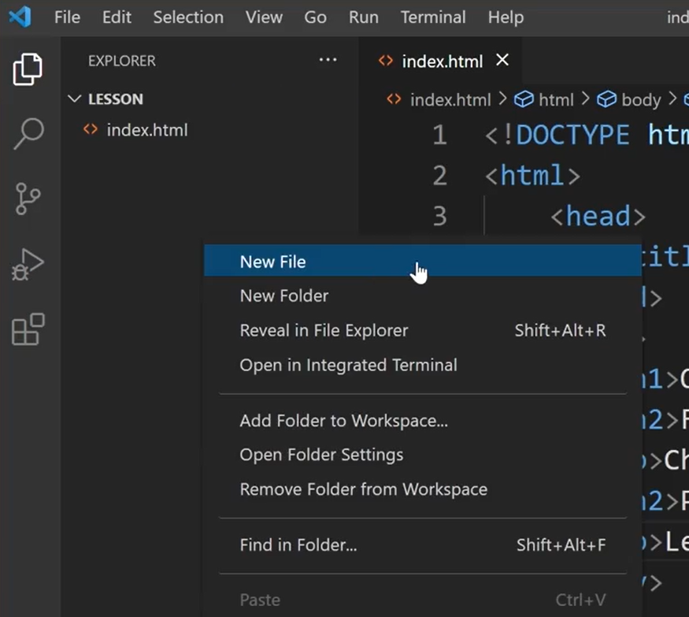
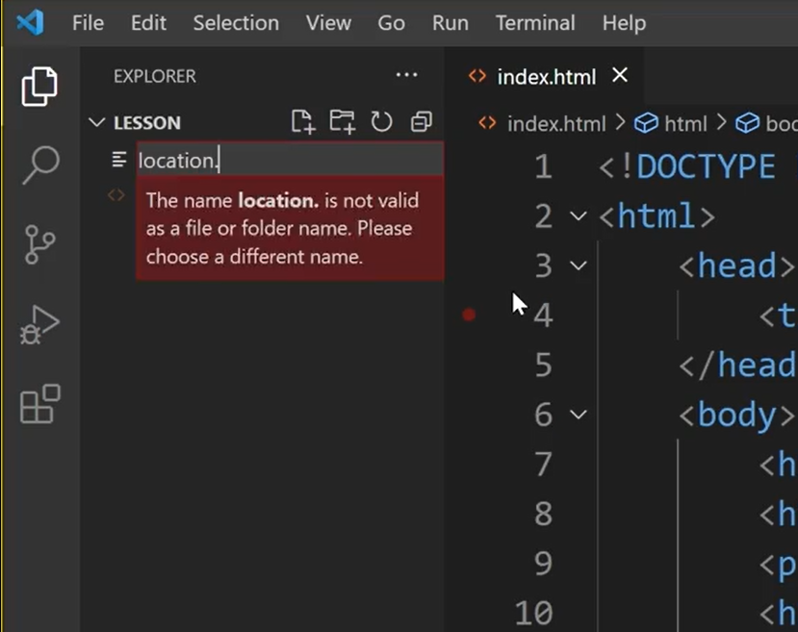
Anchor Tags
I use the same file structure created in my index.html file but add new content.

Slide 5
Anchor Tags
I add a new H1 tag for the heading and type our location.
Next I add a paragraph tag and insert the address “123 Rome Road, Main Districts capital city”.
I press control and S to save the file or command and S on Mac.
Now that my new file with the restaurant location is created.

Slide 6
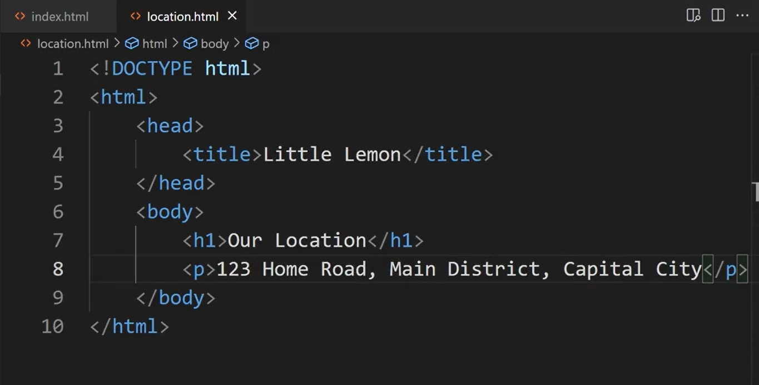
Anchor Tags

Slide 7
Anchor Tags
Let's navigate back to index.html to add a link from there to location.html.
Below the last paragraph tag I add the anchor or <a> tag followed by the href attribute or hypertext reference.
I typed the file name, location.html so that my index.html file will link to it.

Slide 8
Anchor Tags
Within a tag I can also add a descriptive text that is displayed as a link name on my web page. So I type “our location”.
The text our location will now display on the web page in the browser as a clickable link.
Let's test see if it works.

Slide 9
Anchor Tags
I saved the file to update it with the changes and open it in my web browser by right clicking on the index.html file and selecting reveal in file Explorer.
I then double click on the index file. The words are location are displayed in blue by the web browser, success.

Slide 10
If I click on the blue link, the browser opens the location.html file.
You can now link different HTML filestogether to create your website. Best of luck.

Slide 11
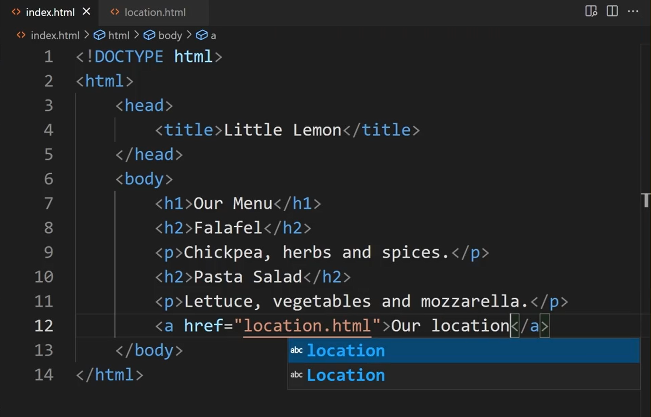
Anchor Tags

Slide 12
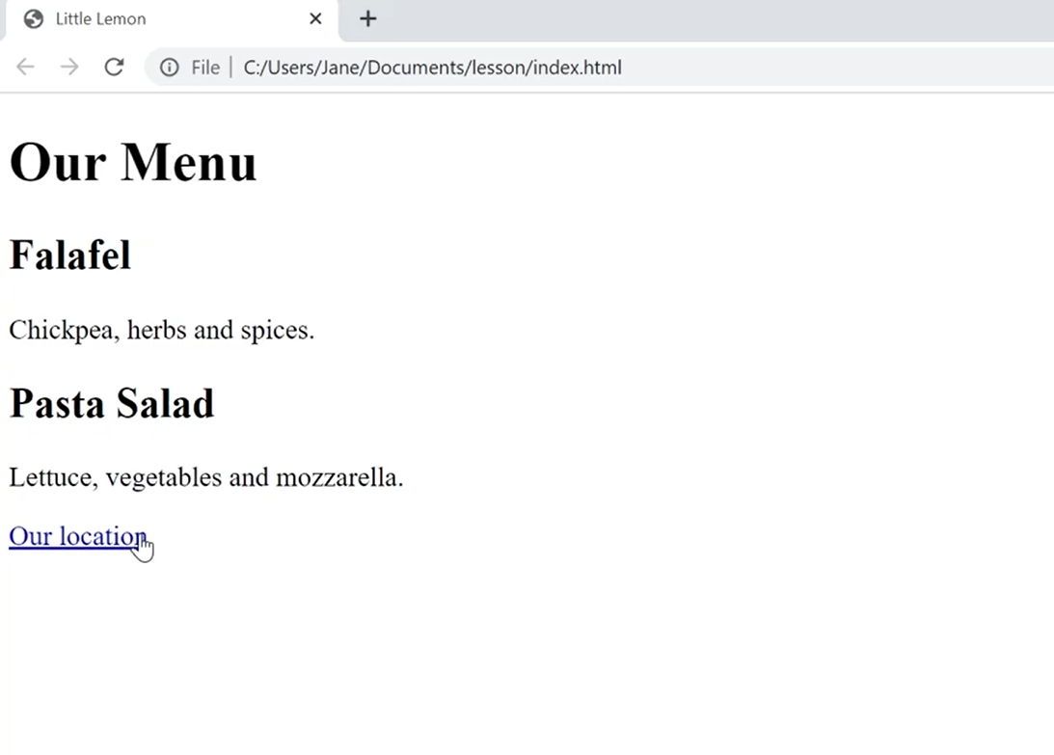
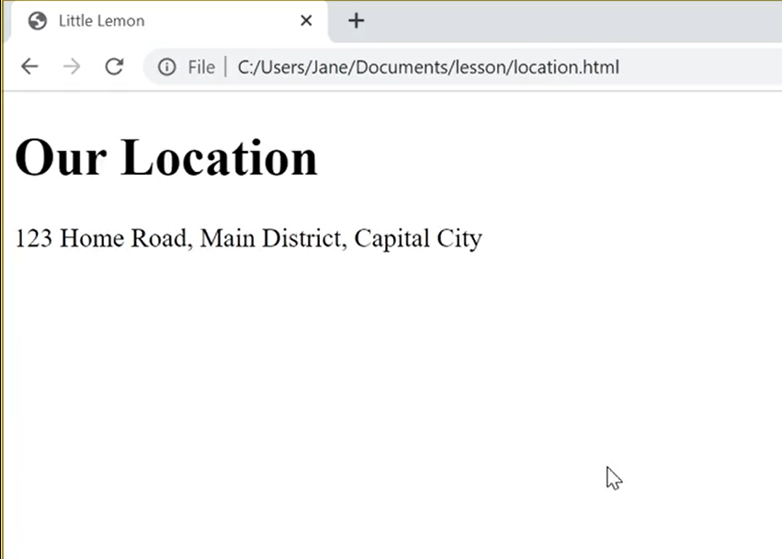
Anchor Tags

Slide 13
Additional Resources
Learn more Here is a list of resources that may be helpful as you continue your learning journey.
HTML Elements Reference (Mozilla)
https://developer.mozilla.org/en-US/docs/Web/HTML/Element
The Form Element (Mozilla)
https://developer.mozilla.org/en-US/docs/Web/HTML/Element/form
What is the Document Object Model? (W3C)
https://www.w3.org/TR/WD-DOM/introduction.html
ARIA in HTML (W3C via Github)
https://w3c.github.io/html-aria/
ARIA Authoring Practices (W3C)
https://www.w3.org/TR/wai-aria-practices-1.2/

Slide 14
Thank You

